Slide 1
AI in Computer vision
By Eng.Ahmd Hisham

Slide 2

Deeplearning.ai brief notes
-Founded in 2017 by Andrew Ng, a global leader in AI.
-Most highlighted organization in ML/DL courses and specialization degrees.
- it has a variety of AI specializations , like deeplearning specialization/machine learning specialization, tensorflow in practice, generative modeling , NLP , AI for medicine , AI for everyone.

Slide 3

Brief introduction about the speaker
bio

Slide 4
Graduated from MSA university faculty of Engineering communications and electronics
Senior and Director of A.I(deep learning specialized) in AITC MUST
Director and project manger of 3 stage deep learning system for covid-19, awareness ,prediction and initial diagnosis co-operated with Academy of science and research technology (ASRT) with fully fund
Worked as deeplearning instructor in ITI 2019
Instructor and part time A.I director at ArabCBT
Speaker in AI opening conference in cairo university faculty of C.S and A.I 2019
Speaker in Innovative day 8 IEEE Elminya
Speaker in Iraqy Tomoh IT webinar
bio

Slide 5
Brief introduction about definition of artificial intelligence
What is computer vision
How to link Computer vision with Artificial intelligence
Use cases of computer vision in our lives
Combining NLP and CV in one architecture ( attention architecture)
How to prepare yourself for the market
Agenda

Slide 6
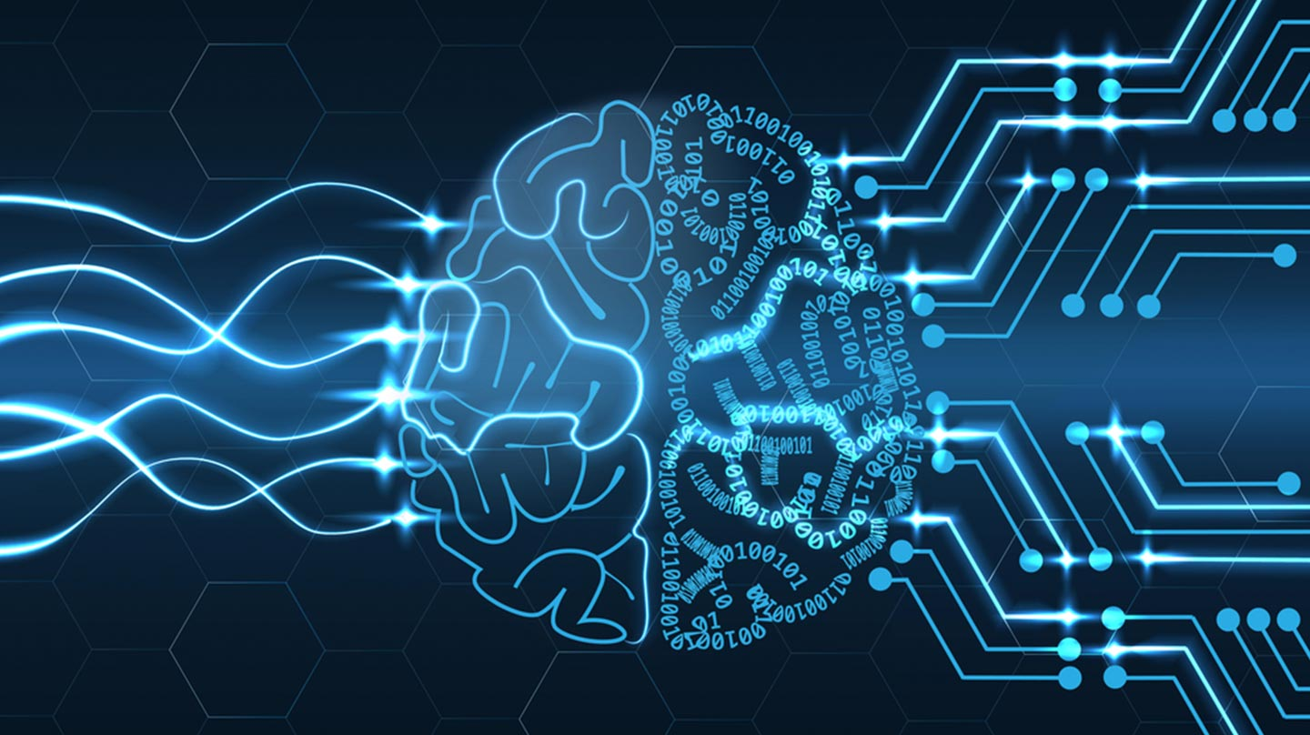
What is AI ?

Slide 7
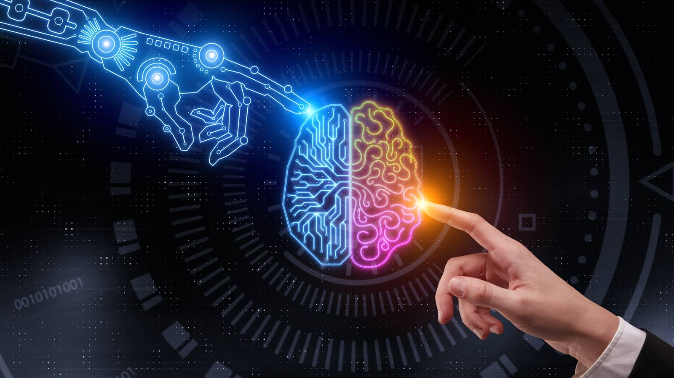
Brief intro

Slide 8
(A.I) refers to the simulation of human intelligence in machines that are programmed to think like humans and mimic their actions
Therefore ideal characteristic of artificial intelligence is its ability to rationalize and take actions that have the best chance of achieving a specific goal.
Artificial intelligence Brief definition
I

Slide 9
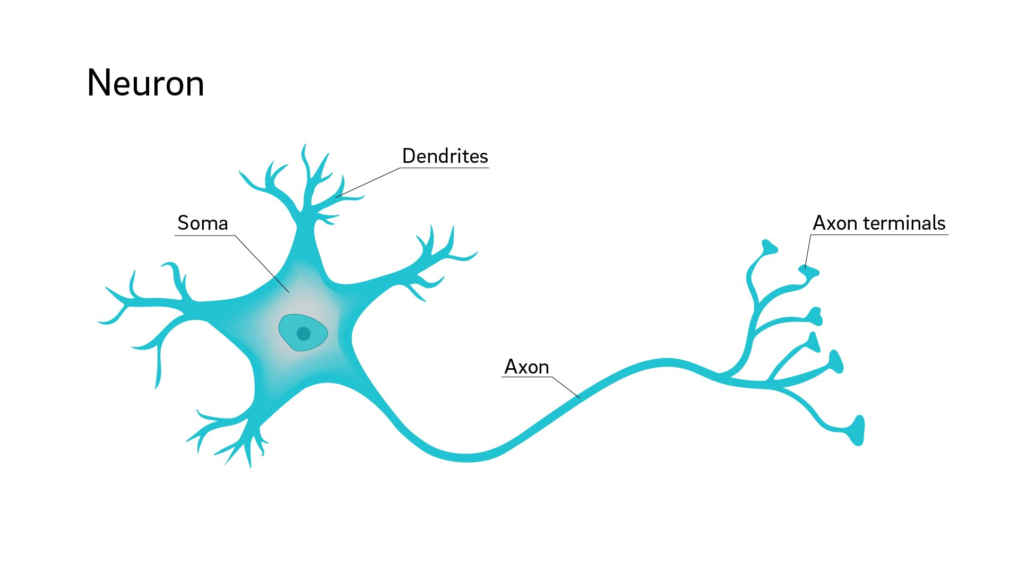
Inspired biologically
Definition of A.I

Slide 10
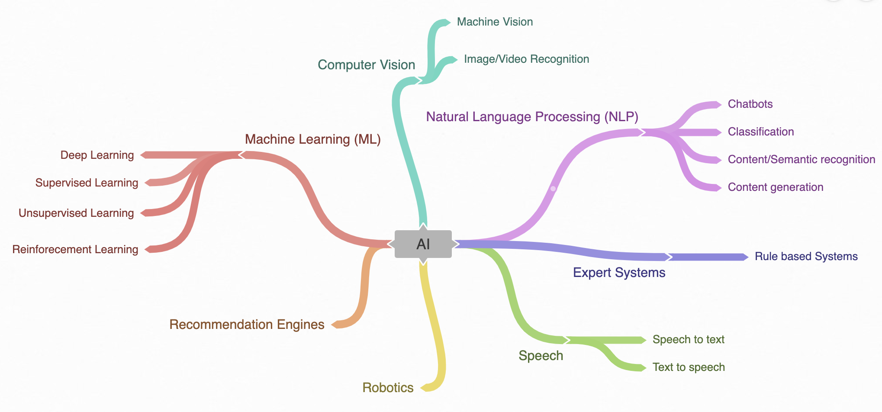
More Specified
Branches of A.I

Slide 11
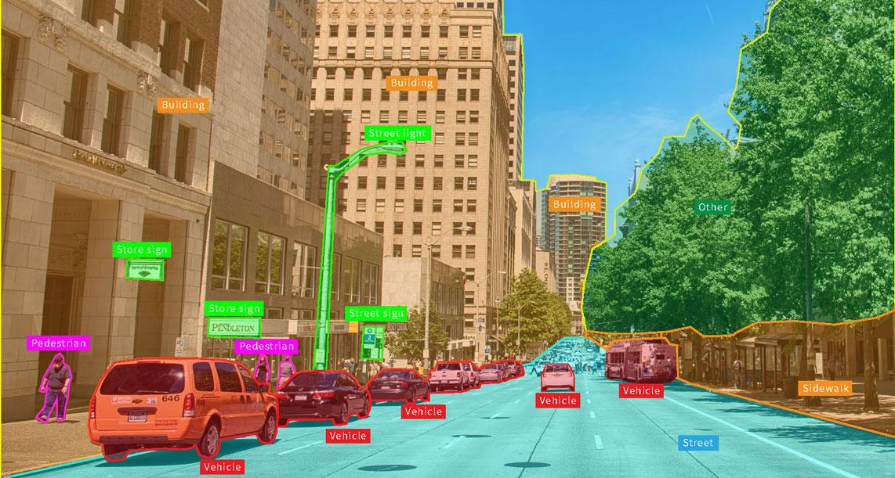
Computervision
Computer Vision

Slide 12
Computer vision is the field of study surrounding how computers see and understand digital images and videos. Computer vision spans all tasks performed by biological vision systems, including "seeing" , understanding what is being seen, and extracting complex information into a form that can be used in other processes.
ComputerVision definition

Slide 13
Facial Recognition
Facial expression recognition ( fer)
Object detection
Landmark detection
Self driving cars
Medical image analysis
Optical character recognition
etc
Applications of computervision
apps

Slide 14
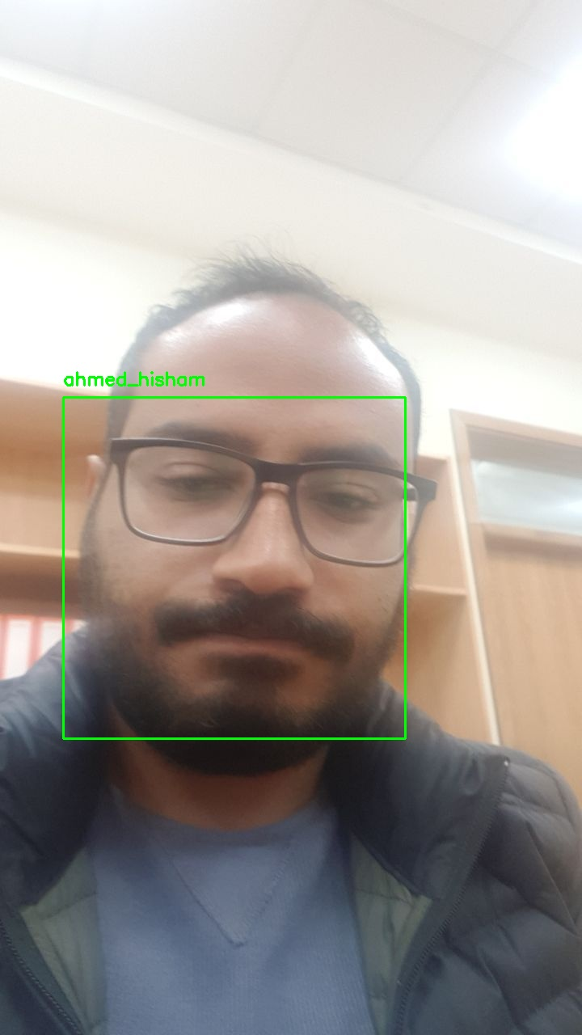
Facial recognition
facial recognition

Slide 15
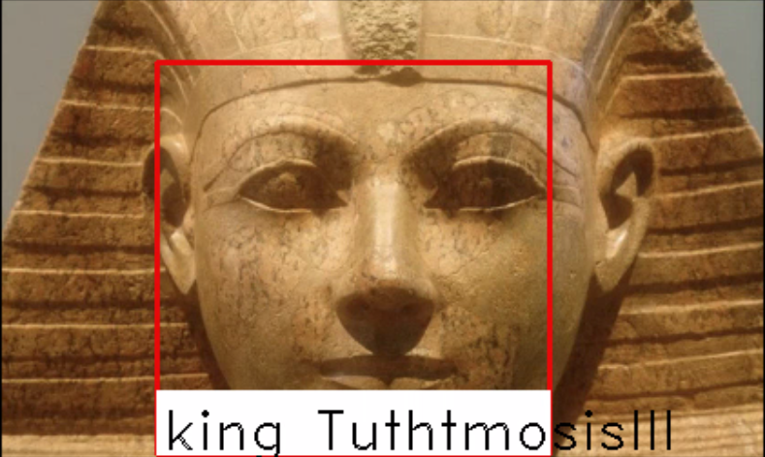
Facial recognition
face recognition

Slide 16
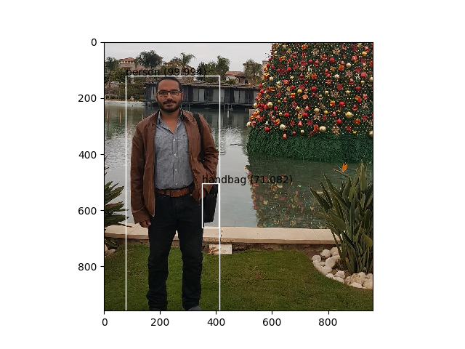
Object detection and recognition
Computer vision advanced object detection

Slide 17
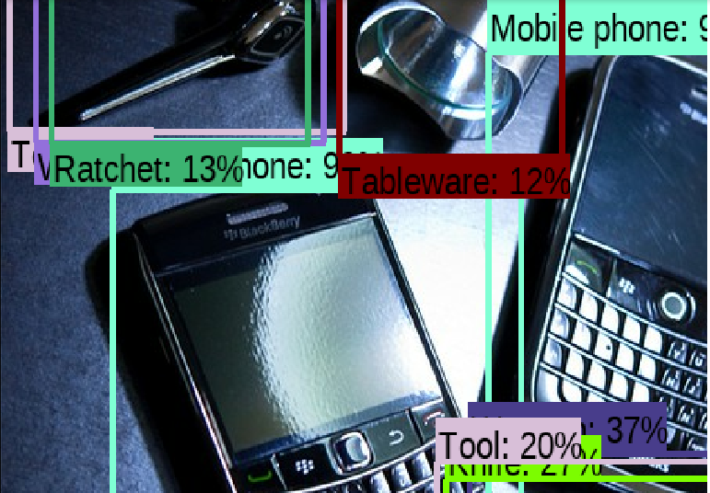
Object detection and recognition
Computer vision advanced object detection

Slide 18
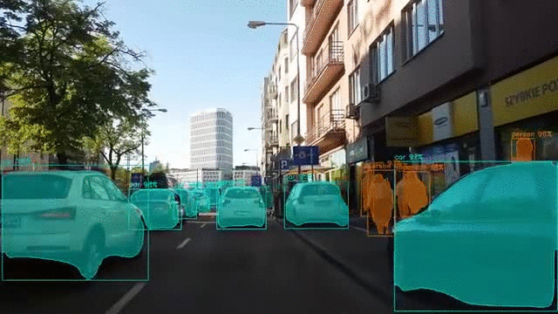
Image segmentation

Slide 19
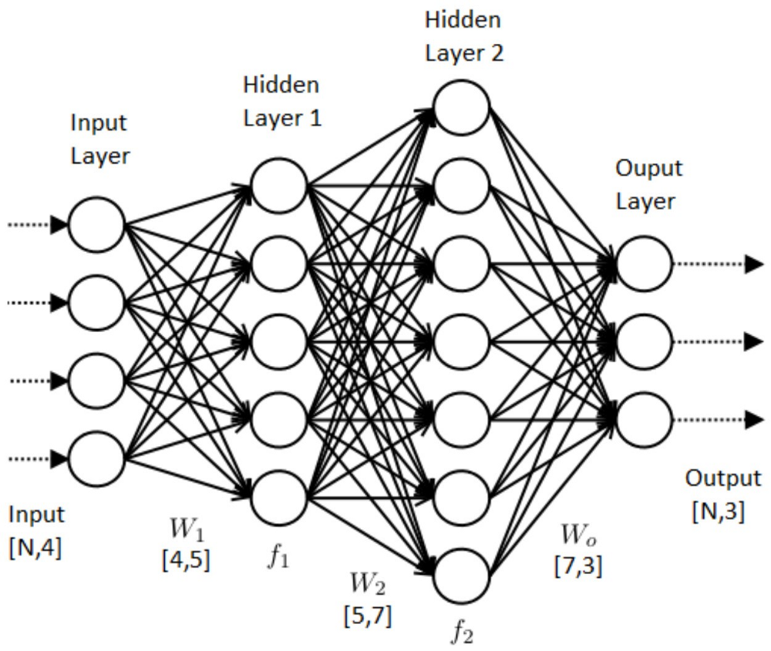
Neural networks
Computer vision advanced illustration

Slide 20
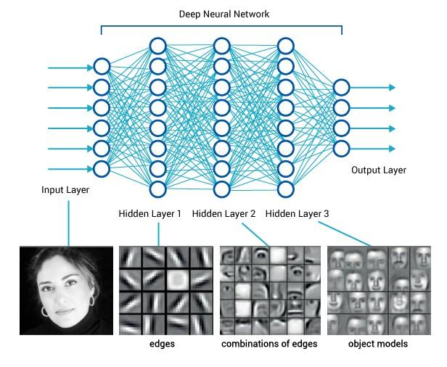
Neural networks
Computer vision advanced illustration

Slide 21
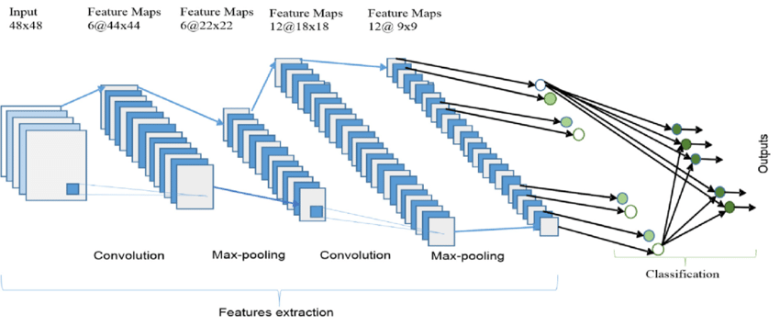
CNN
CNN ( convolutional neural networks )

Slide 22

Neural networks
CNN

Slide 23
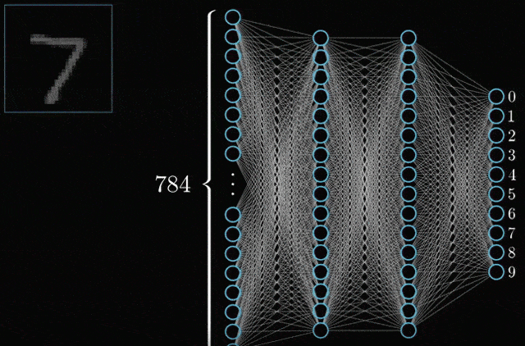
Neural networks
Computer vision advanced illustration

Slide 24

Neural networks
Computer vision advanced illustration

Slide 25
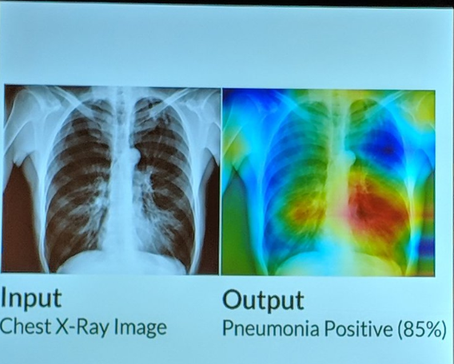
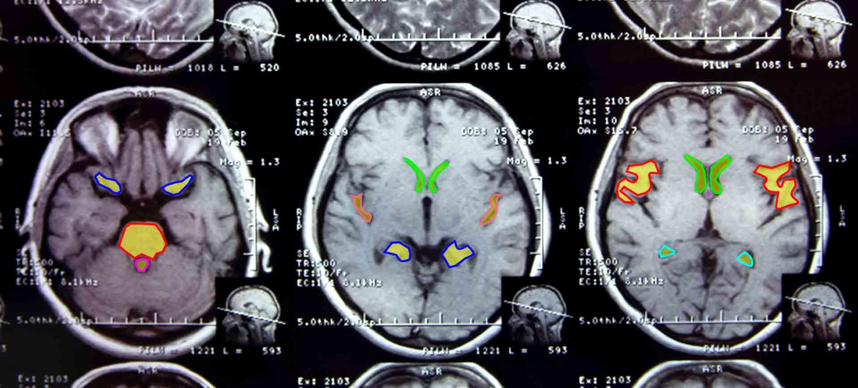
Medical imaging
Computervision in our lives

Slide 26
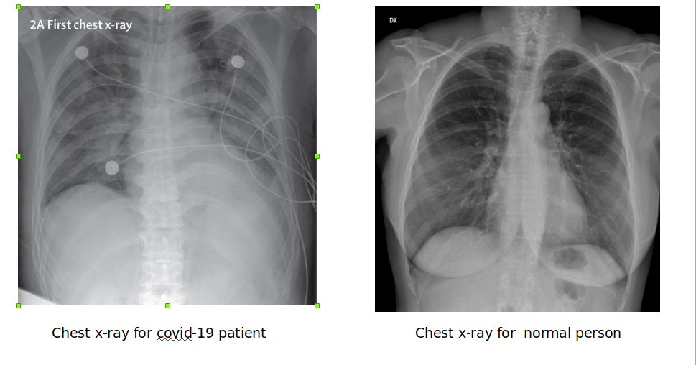
Medical imaging through
The covid-19 pandemic
our lives

Slide 27
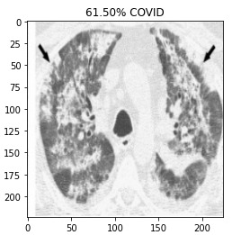
Medical imaging through
The covid-19 pandemic
our lives

Slide 28
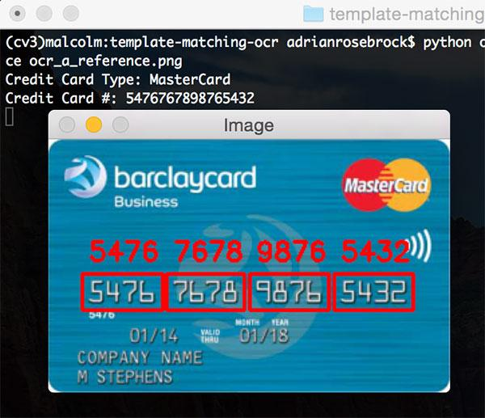
Optical character recognition
Computervision APPs in our lives

Slide 29
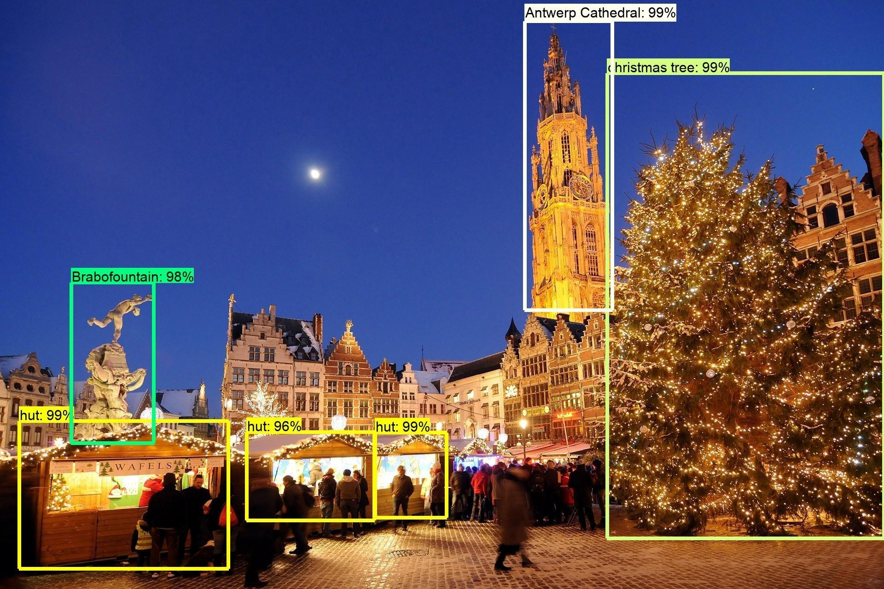
Land mark detection
Computervision APPs in our lives

Slide 30
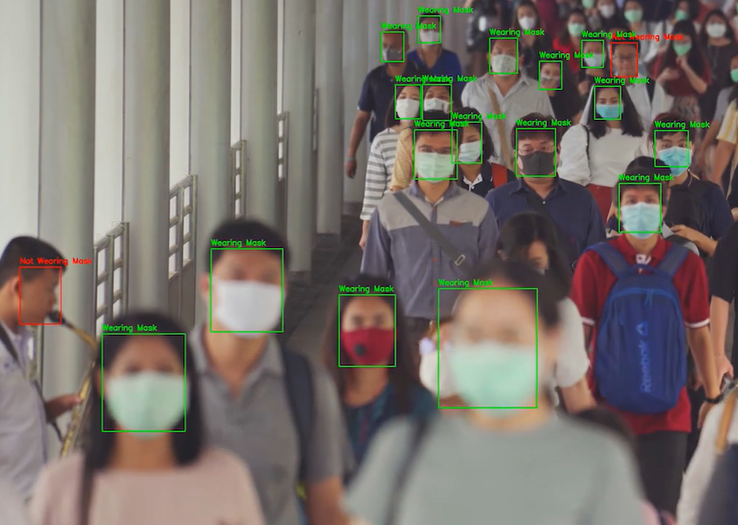
Face mask detection
Computervision APPs in our lives

Slide 31
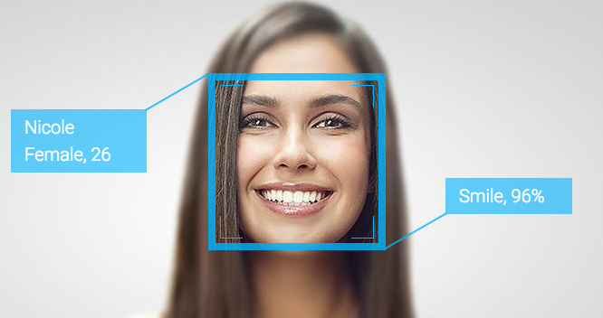
Gender and emotion recognition
Computervision APPs in our lives

Slide 32
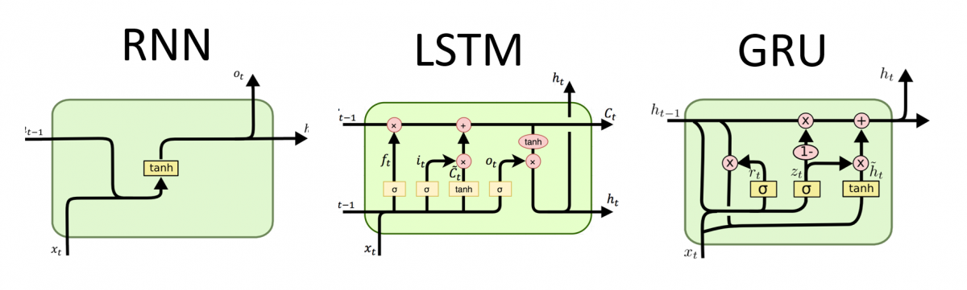
Another Type of Neural Networks
Recurrent neural nets

Slide 33
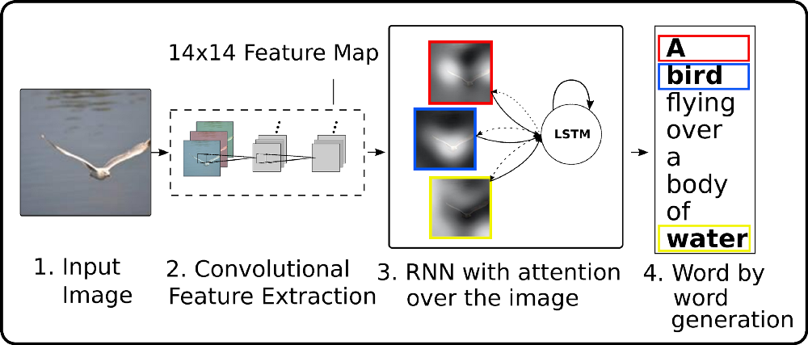
Image captioning with attention
Combining

Slide 34
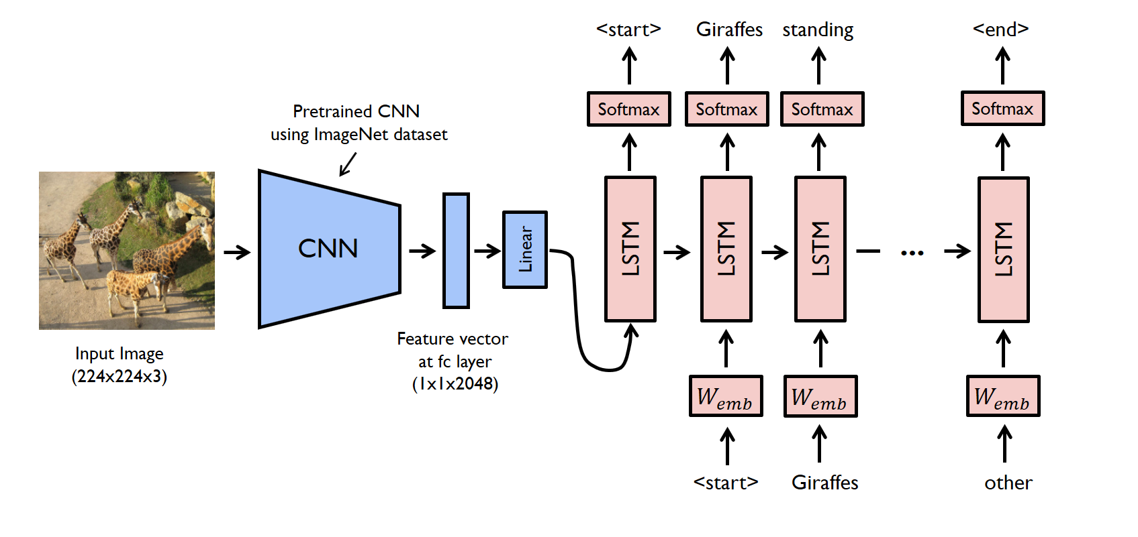
Image captioning with attention
Combining

Slide 35
Requirements
Maths ( linear algebra , statistics and probabilities , calculus )
Problem solving skills
Data structure and algorithm understanding
Programming skills ( python , matlab , c++ , java)
Popular platforms and libraries ( torch , tensorflow , caffee , sckitlearn , opencv , nltk , dialogflow )
Knowledge of Deep learning/ machine learning from academic perspective
Reading academic papers daily
Needed R

Slide 36
Thank you
Thanks

